Slide 1

ETL – Extract Load Transform
TSTT Data Science Initiative
Gabriela Sewdhan, Mariella Rivas, Darren Ramsook, Navin Dookeram, Rafael Guerrero

Slide 2
Course Outline
Lesson 1.
What is ETL?
Lesson 2.
The 3 Step Process
Lesson 3.
Reasons for ETL in Data Science
Lesson 4.
Let’s Build our own ETL Pipeline!
Lesson 5.
Other ways to build an ETL Pipeline.

Slide 3
What is ETL?
How it works
Extract, Transform, Load
You can extract data from any data sources such as:
Files,
any RDBMS/NoSql Database,
Websites or
real-time user activity,
You can then transform the acquired data and then load the transformed data into a data warehouse for business uses such as reporting or analytics.
ETL stands for Extract, Transform and Load. It’s a generic process in which data is firstly acquired, then changed or processed and is finally loaded into data warehouse or databases or other files such as PDF, Excel.

Slide 4
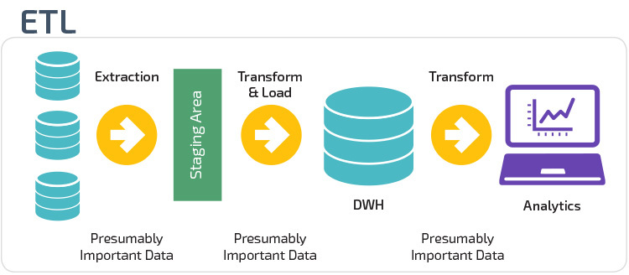
Extract Transform Load

Slide 5
Tutorial Progress
Lesson 1
What is ETL?
Lesson 2
The 3 Step Process
Lesson 3
Reasons for ETL in Data Science
Lesson 4
Let’s Build our own ETL Pipeline!
Lesson 5
Other ways to build an ETL Pipeline

Slide 6




3 Step Process
Transform
Transforming Data as per business logic. Transformation is in itself a two steps process- data cleansing and data manipulation.
Extract
Load
Extracting Data from single or multiple Data Sources
Loading transformed data into the target data source or data warehouse.

Slide 7
Tutorial Progress
Lesson 1
What is ETL?
Lesson 2
The 3 Step Process
Lesson 3
Reasons for ETL in Data Science
Lesson 4
Let’s Build our own ETL Pipeline!
Lesson 5
Other ways to build an ETL Pipeline

Slide 8
Why ETL?
Key reasons for using ETL are:
Visualizing your entire data flow pipeline which helps business taking critical business decisions.
Transactional databases cannot answer complex business questions that can be answered by ETL.
ETL provides a method of moving the data from various sources into a data warehouse.
As data sources change, the Data Warehouse will automatically update.
ETL process can perform complex transformations and requires the extra area to store the data.
ETL helps to Migrate data into a Data Warehouse. Convert to the various formats and types to adhere to one consistent system.
ETL is a predefined process for accessing and manipulating source data into the target database.
ETL offers deep historical context for the business.

Slide 9
Tutorial Progress
Lesson 1
What is ETL?
Lesson 2
The 3 Step Process
Lesson 3
Reasons for ETL in Data Science
Lesson 4
Let’s Build our own ETL Pipeline!
Lesson 5
Other ways to build an ETL Pipeline

Slide 10
Tutorial Progress
Lesson 1
What is ETL?
Lesson 2
The 3 Step Process
Lesson 3
Reasons for ETL in Data Science
Lesson 4
Let’s Build our own ETL Pipeline!
Lesson 5
Other ways to build an ETL Pipeline

Slide 11
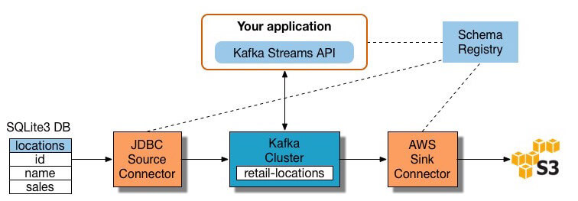
Building an ETL Pipeline with Stream Processing
Many stream processing tools are available today - including Apache Samza, Apache Storm, and Apache Kafka. The diagram below illustrates an ETL pipeline based on Kafka:-
Building streaming ETL based on Kafka involves:
Extracting data into Kafka
Pulling data from Kafka topics
Transform data in KStream object
Load data to other systems
Notes:
Modern data processes often include real time data - for example, web analytics data from a large ecommerce website. In these use cases, you cannot extract and transform data in large batches: the need arises to perform ETL on data streams. This means that as client applications write data to the data source, data should be treated, transformed and saved immediately to the target data store.

Slide 12
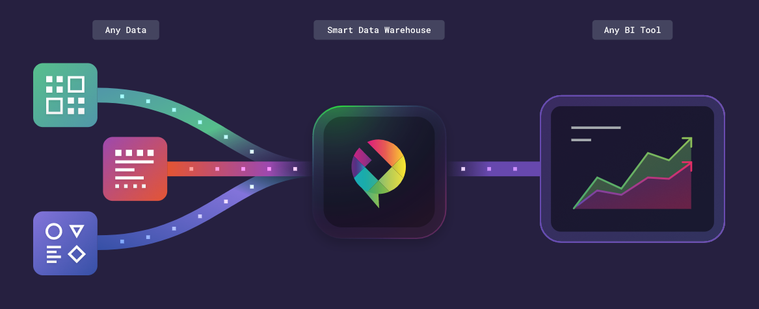
Building a Pipeline without ETL Using an Automated Cloud-Based Data Warehouse
New cloud-based data warehouse technology makes it possible to achieve the original goal of ETL without building an ETL system at all.
For example, Panoply’s cloud-based automated data warehouse has end-to-end data management built in.
It uses a self-optimizing architecture with machine learning and natural language processing (NLP), which automatically extracts and transforms data to match analytics requirements.
Panoply comes pre-integrated with dozens of data sources, including analytics systems, BI tools, databases, social and advertising platforms.

Slide 13
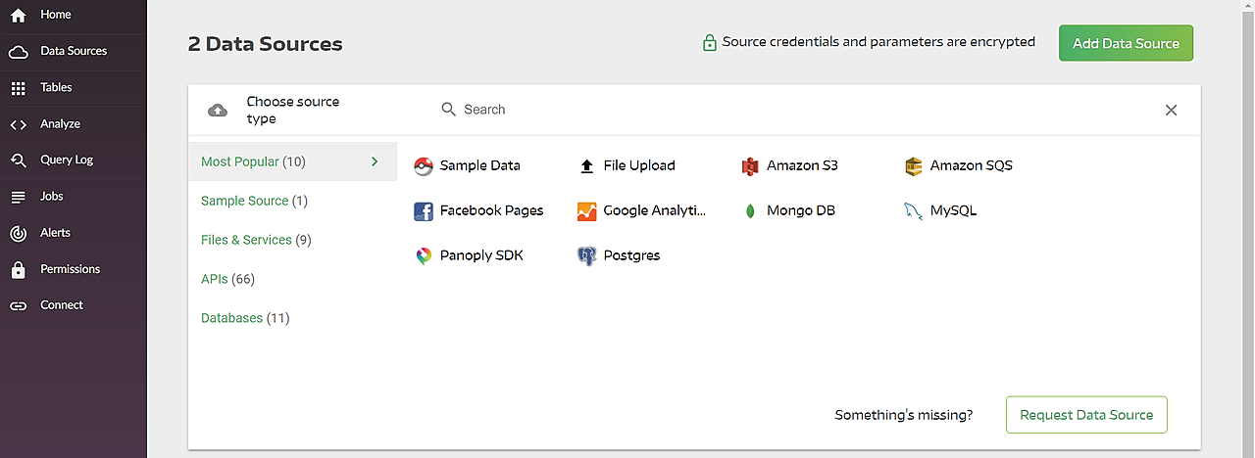
Building a data pipeline without ETL in Panoply involves:
Select data sources and import data - select your data sources from a list, enter credentials and define destination tables, click Collect and Panoply automatically pulls the data for you.
Run transformation queries - select a table and run a SQL query against the raw data. You can save the query as a transformation, or export the resulting table into your own system.
Data analysis with BI tools - you can now connect any BI tool such as Tableau or Looker to Panoply and explore the transformed data.

Slide 14
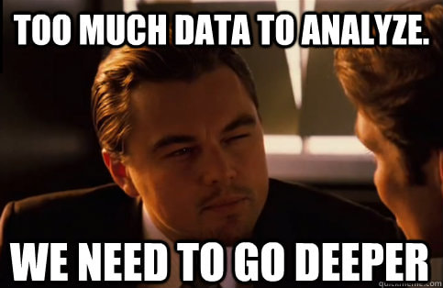
Additional Resources
EDX Course for implementing ETL with SQL Server Integration Services: https://www.edx.org/course/implementing-etl-with-sql-server-integration-servi
More on Building ETLs in different ways: https://panoply.io/data-warehouse-guide/3-ways-to-build-an-etl-process/
Building an ETL Pipeline Using R: https://www.datacamp.com/community/tutorials/building-a-tweet-etl-pipeline-using-r
Building an ETL Pipeline Using Python: https://www.dataquest.io/blog/data-pipelines-tutorial/

Slide 15



